Slide 1
AP Physics C
Electricity and Magnetism Review

Slide 2
Electrostatics – 30%
Chap 22-25
Charge and Coulomb’s Law
Electric Field and Electric Potential (including point charges)
Gauss’ Law
Fields and potentials of other charge distributions

Slide 3
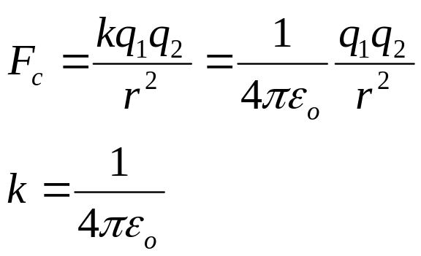
Electrostatics
Charge and Coulomb’s Law
There are two types of charge: positive and negative
Coulomb’s Law:
Use Coulomb’s Law to find the magnitude of the force, then determine the direction using the attraction or repulsion of the charges.

Slide 4
Electrostatics
Electric Field
Defined as electric force per unit charge. Describes how a charge or distribution of charge modifies the space around it.
Electric Field Lines – used to visualize the E-Field.
E-Field always points the direction a positive charge will move.
The closer the lines the stronger the E-Field.

Slide 5
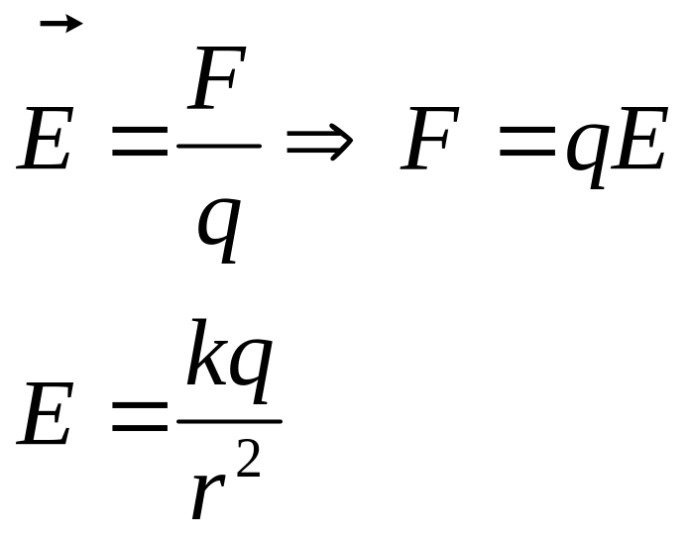
Electrostatics
Electric Field
E-Field and Force
E-Field for a Point Charge

Slide 6
Electrostatics
Electric Field – Continuous Charge Distribution
This would be any solid object in one, two or three dimensions.
Break the object into individual point charges and integrate the electric field from each charge over the entire object.
Use the symmetry of the situation to simplify the calculation.
Page 530 in your textbook has a chart with the problem solving strategy

Slide 7
Electrostatics
Gauss’ Law
Relates the electric flux through a surface to the charge enclosed in the surface
Most useful to find E-Field when you have a symmetrical shape such as a rod or sphere.
Flux tells how many electric field lines pass through a surface.

Slide 8
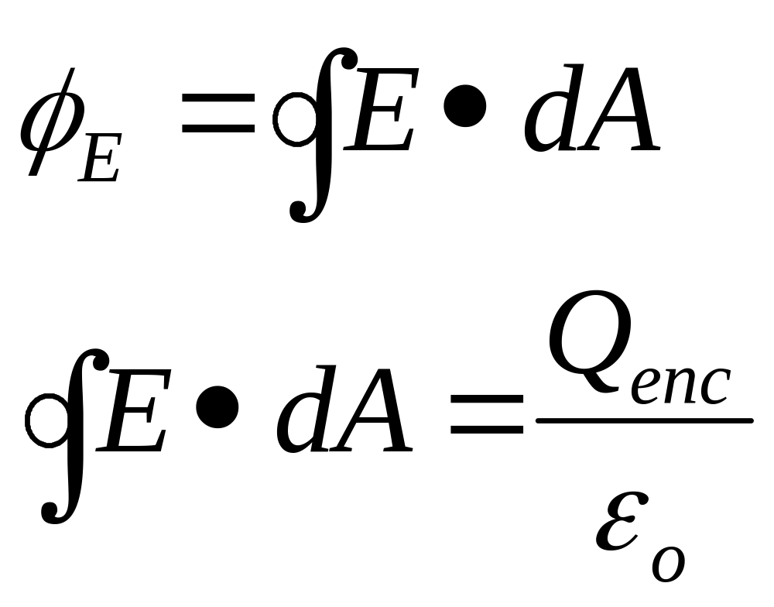
Electrostatics
Gauss’ Law
Electric Flux
Gauss’ Law

Slide 9
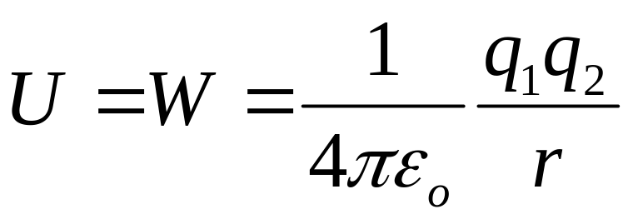
Electric Potential (Voltage)
Electric Potential Energy for a point charge. To find total U, sum the energy from each individual point charge.
Electric Potential –
    Electric potential energy per unit charge
    It is a scalar quantity – don’t need to worry about direction just the sign
    Measured in Volts (J/C)

Slide 10
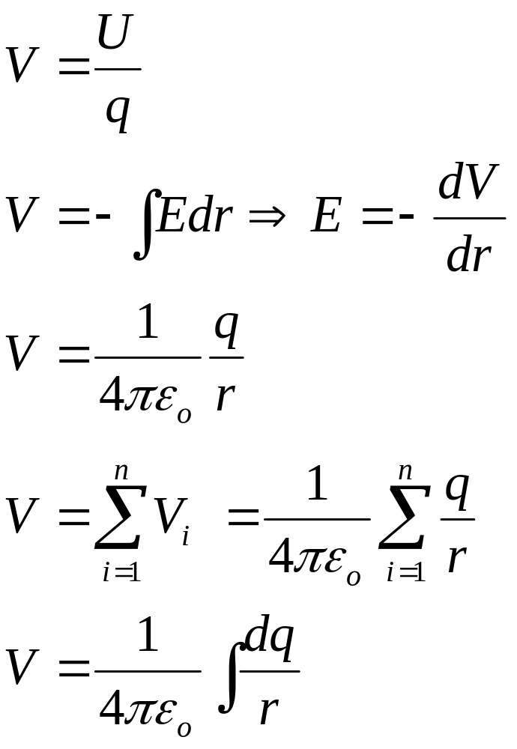
Electric Potential (Voltage)
Definition of Potential
Potential and E-Field Relationship
Potential for a Point Charge
Potential for a collection of point charges
Potential for a continuous charge distribution

Slide 11
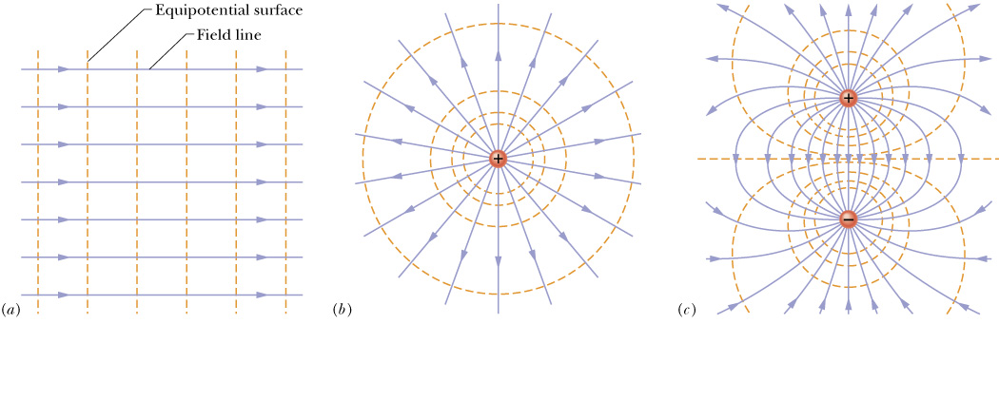
Equipotential Surfaces
A surface where the potential is the same at all points.
Equipotential lines are drawn perpendicular to E-field lines.
As you move a positive charge in the direction of the electric field the potential decreases.
It takes no work to move along an equipotential surface

Slide 12
Conductors, Capacitors, Dielectrics – 14%
Chapter 26
Electrostatics with conductors
Capacitors
  Capacitance
  Parallel Plate
  Spherical and cylindrical
Dielectrics

Slide 13
Charged Isolated Conductor
A charged conductor will have all of the charge on the outer edge.
There will be a higher concentration of charges at points
The surface of a charged isolated conductor will be equipotential (otherwise charges would move around the surface)

Slide 14
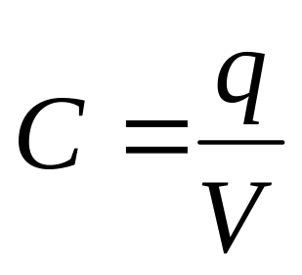
Capacitance
Capacitors store charge on two ‘plates’ which are close to each other but are not in contact.
Capacitors store energy in the electric field.
Capacitance is defined as the amount of charge per unit volt. Units – Farads (C/V) Typically capacitance is small on the order of mF or μF

Slide 15
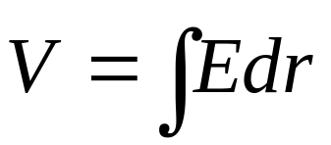
Calculating Capacitance
Assume each plate has charge q
Find the E-field between the plates in terms of charge using Gauss’ Law.
Knowing the E-field, find the potential. Integrate from the negative plate to the positive plate (which gets rid of the negative)
Calculate C using

Slide 16
Calculating Capacitance
You may be asked to calculate the capacitance for
  Parallel Plate Capacitors
  Cylindrical Capacitors
  Spherical Capacitors

Slide 17
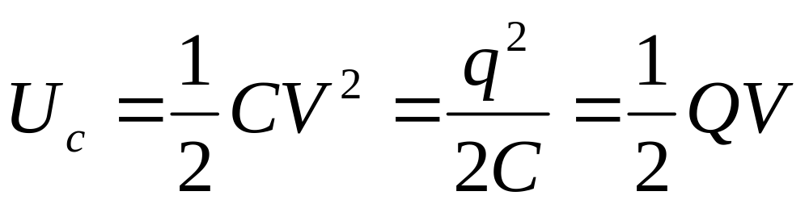
Capacitance - Energy
Capacitors are used to store electrical energy and can quickly release that energy.

Slide 18
Capacitance
Dielectrics
Dielectrics are placed between the plates on a capacitor to increase the amount of charge and capacitance of a capacitor
The dielectric polarizes and effectively decreases the strength of the E-field between the plates allowing more charge to be stored.
Mathematically, you simply need to multiply the ε_{o} by the dielectric constant κ in Gauss’ Law or wherever else ε_{o} appears.

Slide 19
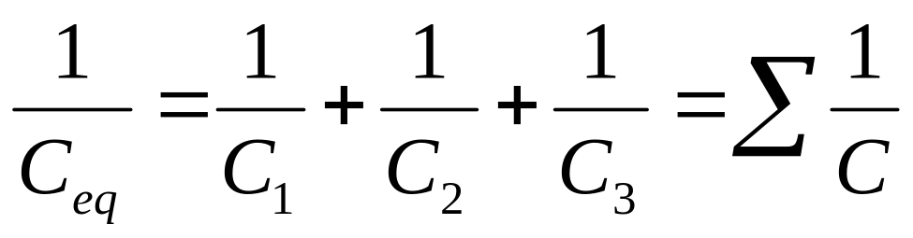
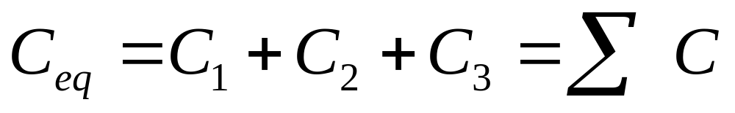
Capacitors in Circuits
Capacitors are opposite resistors mathematically in circuits
Series
Parallel

Slide 20
Electric Circuits – 20%
Chapter 27 & 28
Current, resistance, power
Steady State direct current circuits w/ batteries and resistors
Capacitors in circuits
  Steady State
  Transients in RC circuits

Slide 21
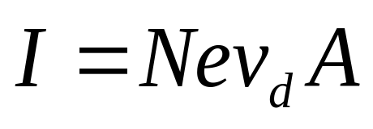
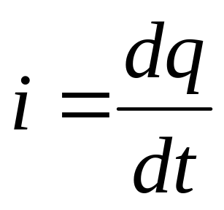
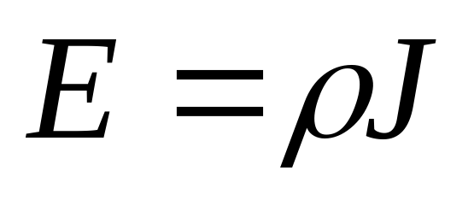
Current
Flow of charge
Conventional Current is the flow of positive charge – what we use more often than not
Drift velocity (v_{d})– the rate at which electrons flow through a wire. Typically this is on the order of 10⁻³ m/s.
E-field = resistivity * current density

Slide 22
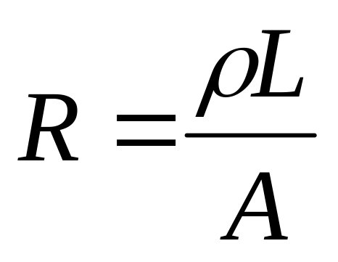
Resistance
Resistance depends on the length, cross sectional area and composition of the material.
Resistance typically increases with temperature

Slide 23
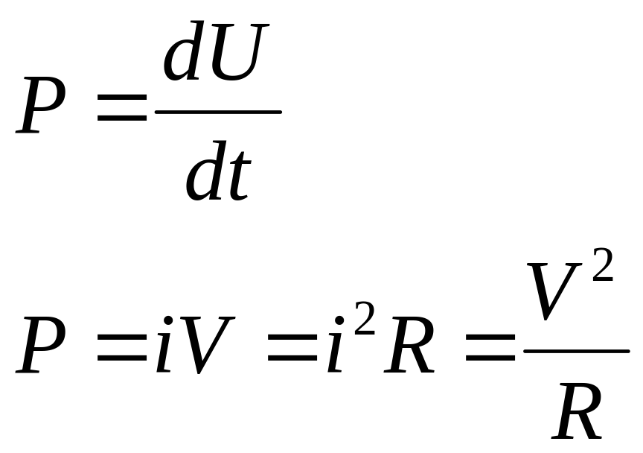
Electric Power
Power is the rate at which energy is used.

Slide 24
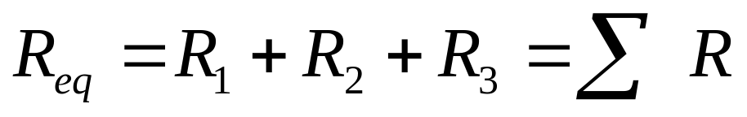
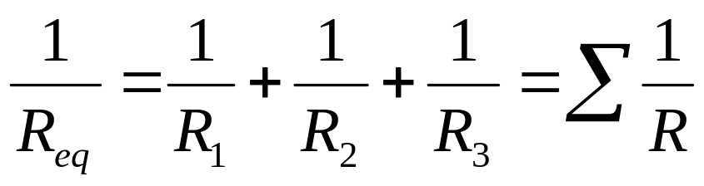
Circuits
Series – A single path back to battery. Current is constant, voltage drop depends on resistance.
Parallel - Multiple paths back to battery. Voltage is constant, current depends on resistance in each path
Ohm’s Law => V = iR

Slide 25
Circuits
Solving
Can either use Equivalent Resistance and break down circuit to find current and voltage across each component
Kirchoff’s Rules
  Loop Rule – The sum of the voltages around a closed loop is zero
  Junction Rule – The current that goes into a junction equals the current that leaves the junction
  Write equations for the loops and junctions in a circuit and solve for the current.

Slide 26
Ammeters and Voltmeters
Ammeters – Measure current and are connected in series
Voltmeters – measure voltage and are place in parallel with the component you want to measure

Slide 27
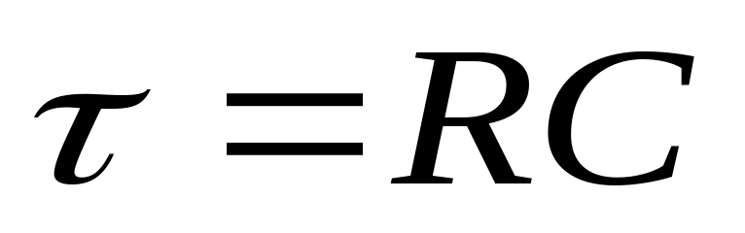
RC Circuits
Capacitors initially act as wires and current flows through them, once they are fully charged they act as broken wires.
The capacitor will charge and discharge exponentially – this will be seen in a changing voltage or current.

Slide 28
Magnetic Fields – 20%
Chapter 29 & 30
Forces on moving charges in magnetic fields
Forces on current carrying wires in magnetic fields
Fields of long current carrying wire
Biot-Savart Law
Ampere’s Law

Slide 29
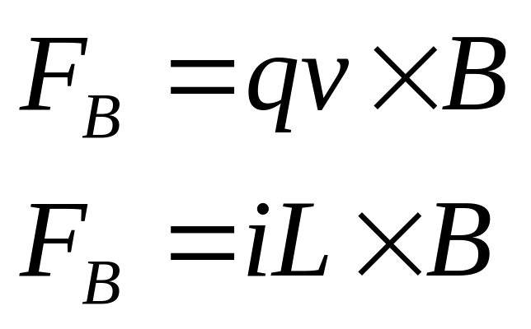
Magnetic Fields
Magnetism is caused by moving charges
Charges moving through a magnetic field or a current carrying wire in a magnetic field will experience a force.
Direction of the force is given by right hand rule for positive charges
v, I – Index Finger
B – Middle Finger
F - Thumb

Slide 30
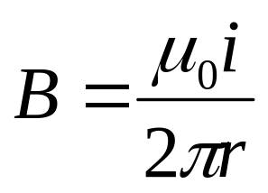
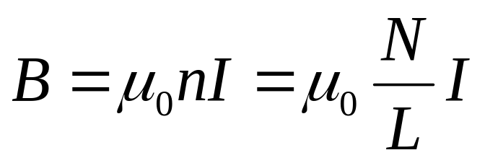
Magnetic Field
Wire and Soleniod
It is worth memorizing these two equations
  Current Carrying Wire
  Solenoid

Slide 31
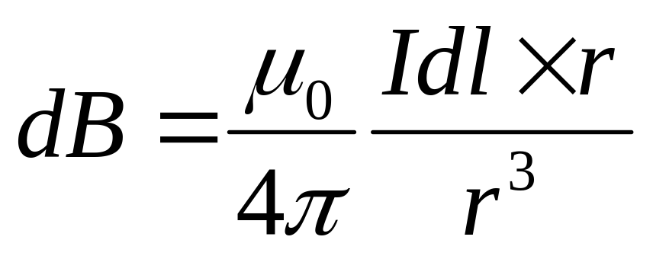
Biot-Savart
Used to find the magnetic field of a current carrying wire
Using symmetry find the direction that the magnetic field points.
r is the vector that points from wire to the point where you are finding the B-field
Break wire into small pieces, dl, integrate over the length of the wire.
Remember that the cross product requires the sine of the angle between dl and r.
This will always work but it is not always convenient

Slide 32
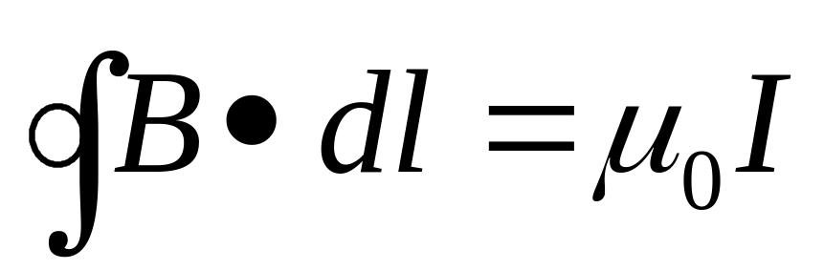
Ampere’s Law
Allows you to more easily find the magnetic field, but there has to be symmetry for it to be useful.
You create an Amperian loop through which the current passes
The integral will be the perimeter of your loop. Only the components which are parallel to the magnetic field will contribute due to the dot product.

Slide 33
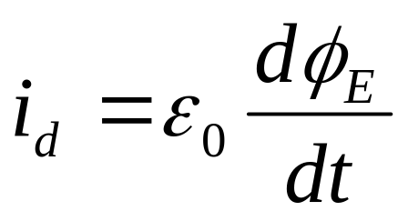
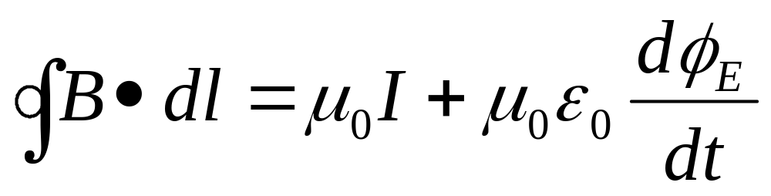
Ampere’s Law
Displacement Current – is not actually current but creates a magnetic field as the electric flux changes through an area.
The complete Ampere’s Law, in practice only one part will be used at a time and most likely the µ_{o}I component.

Slide 34
Electromagnetism – 16%
Chapter 31-34
Electromagnetic Induction
  Faraday’s Law
  Lenz’s Law
Inductance
  LR and LC circuits
Maxwell’s Equations

Slide 35
Faraday’s Law
Potential can be induced by changing the magnetic flux through an area.
This can happen by changing the magnetic field, changing the area of the loop or some combination of these two.
The basic idea is that if the magnetic field changes you create a potential which will cause a current.

Slide 36
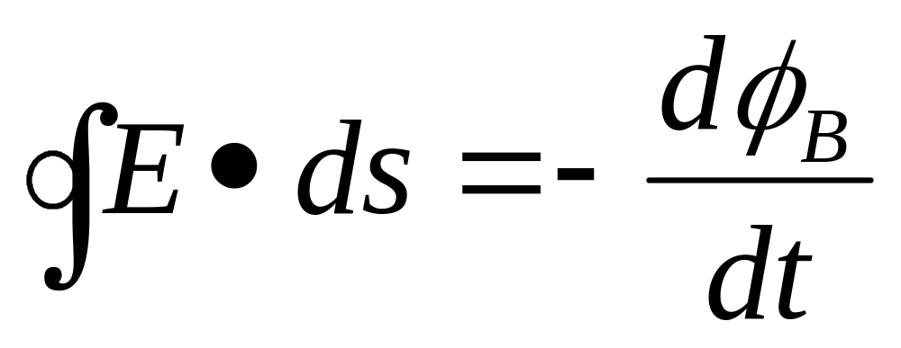
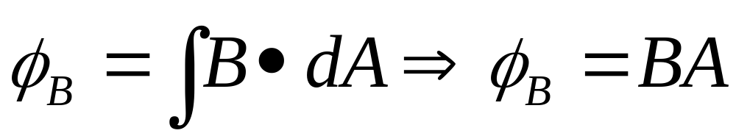
Faraday’s Law
You will differentiate over either the magnetic field or the area. The other quantity will be constant. The most common themes are a wire moving through a magnetic field, a loop that increases in size, or a changing magnetic field.

Slide 37
Lenz’s Law
Lenz’s Law tells us the direction of the induced current.
The induced current will create a magnetic field that opposes the change in magnetic flux which created it.
  If the flux increases, then the induced magnetic field will be opposite the original field
  If the flux decreases, then the induced magnetic field will be in the same direction as the original field

Slide 38
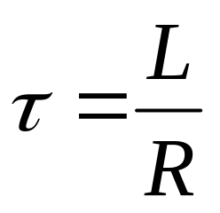
LR Circuits
In a LR circuit, the inductor initially acts as a broken wire and after a long time it acts as a wire.
The inductor opposes the change in the magnetic field and effectively is like ‘electromagnetic inertia’
The inductor will charge and discharge exponentially.
The time constant is

Slide 39
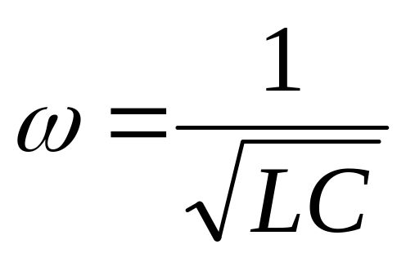
LC Circuits
Current in an LC circuit oscillates between the electric field in the capacitor and the magnetic field in the inductor.
Without a resistor it follows the same rules as simple harmonic motion.

Slide 40
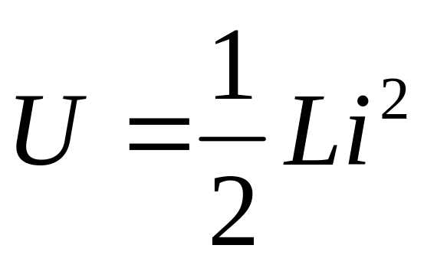
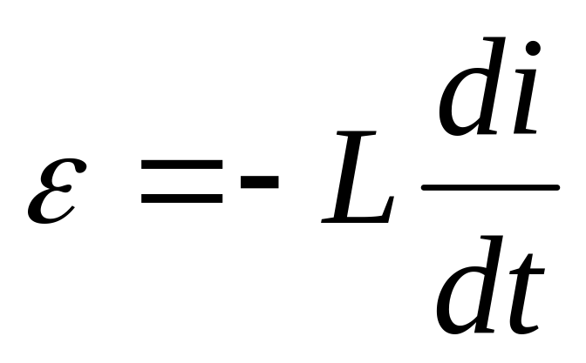
Inductors
Energy Storage
Voltage Across

Slide 41
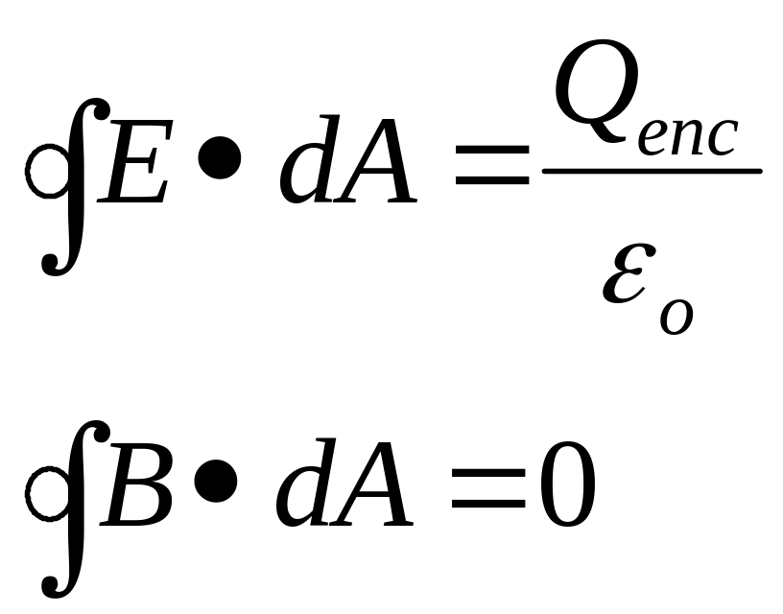
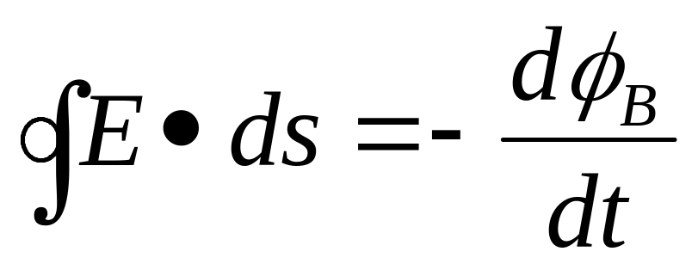
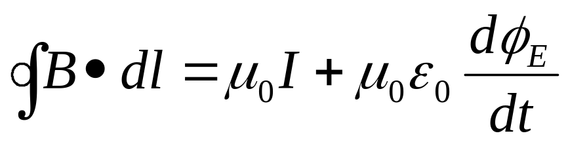
Maxwell’s Equations
Equations which summarize all of electricity and magnetism.

